Slide 1
Data Pipelines project – Companies’ ESG data
Shweta Yadav

Slide 2
Project Motivation
Oil & Gas to Energy Industry
Energy Transition
Sustainability
Environmental Social and Governance (ESG)

Slide 3
Web Scraping Project
Forbes 2000 companies
Financial Metrics
ESG information
Company data

Slide 4






Dataset sources

Slide 5
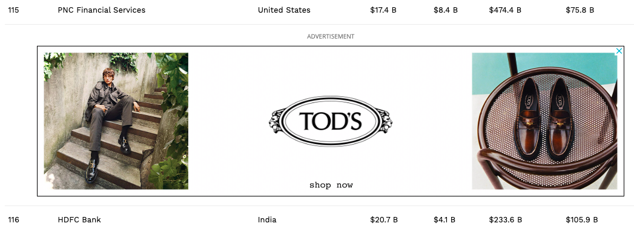
Webpages Layout

Slide 6
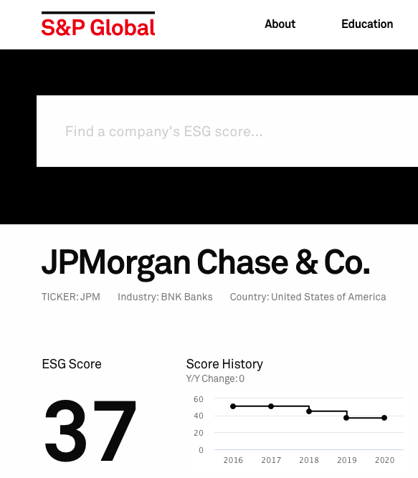
Webpages Layout

Slide 7
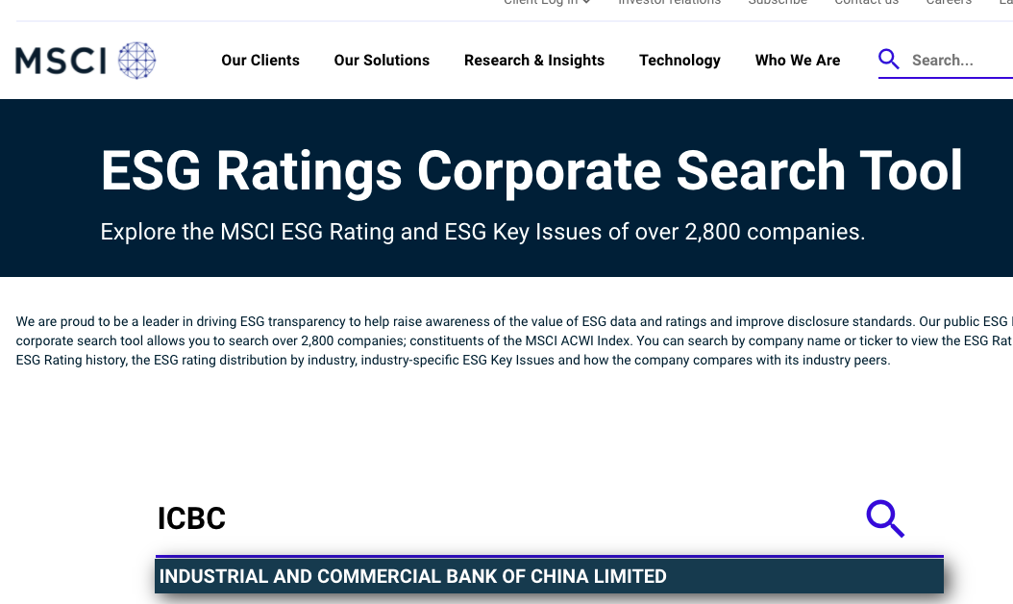
Webpages Layout

Slide 8
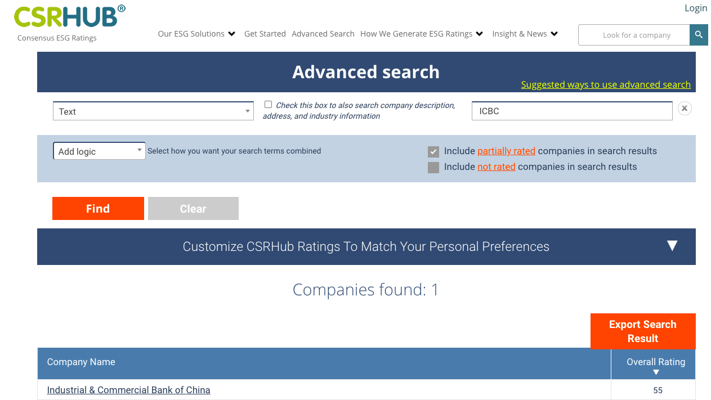
Webpages Layout

Slide 9
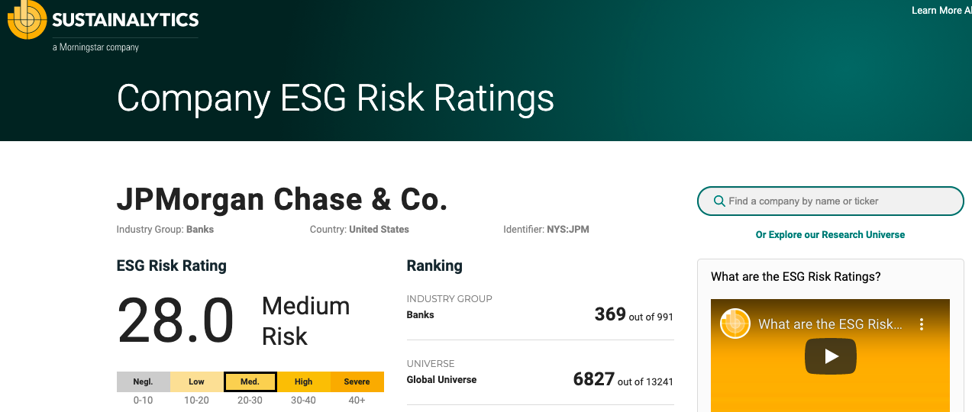
Webpages Layout

Slide 10
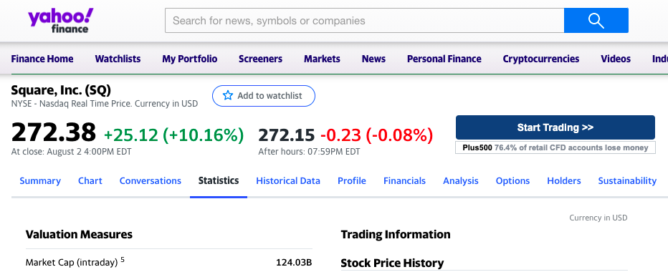
Webpages Layout

Slide 11


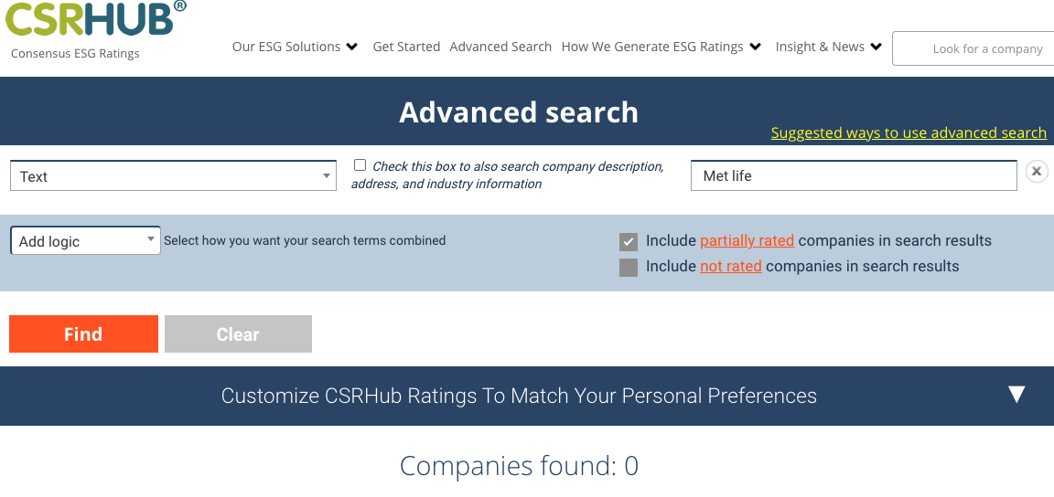
Initial Data Cleaning

Slide 12
Generated Dataset
.
.
.
Company Name | Country | Industry | Market Cap | Price/Earnings | ESG Score
….
.
.
.
.
.
.
.
.
.
.
2000 Rows and 30 columns
.
.
.
Notes:
How they are valued in the market

Slide 13
Classes
AWS EC2
AWS S3

Slide 14
Companies ESG scraper

Slide 16
Energy TRANSITION

Slide 17
SUSTAINABLE FINANCE

Slide 18
https://greenriverfinserv.com/low-carbon-sustainable-investing/

Slide 22
Companies

Slide 23
BONUS : Example Dataset

Slide 24
DOWNLOAD NOW!
conda create --name test_pypi python=3.8
conda activate test_pypi
python3 -m pip install Companies-ESG-metrics==1.1
conda deactivate

Slide 25
HOW-TO-USE Tutorial
Package structure:
WebScraping
- project -- esgscraper -- rds_uploader
- tests
- Forbes.csv
- .gitignore
- LICENSE
- README.md
- setup.cfg
- setup.py
--- __init__.py
--- esgdata.py
--- scraper.py
--- csrhub.py
--- snp_global.py
--- msci.py
--- sustainanalytics.py
--- yahoo.py
--- __init__.py
--- rds_module.py
RUN

Slide 26
THANKS

